Slide 1

Introduction to Monero
And a lesson in privacy and coin equality
Justin Ehrenhofer
Organizer, Monero Community Workgroup
Compliance Analyst, DV Chain

Slide 2





is:
a community-driven,
open source project that
makes safe digital cash
and owns up to its shortcomings

Slide 3
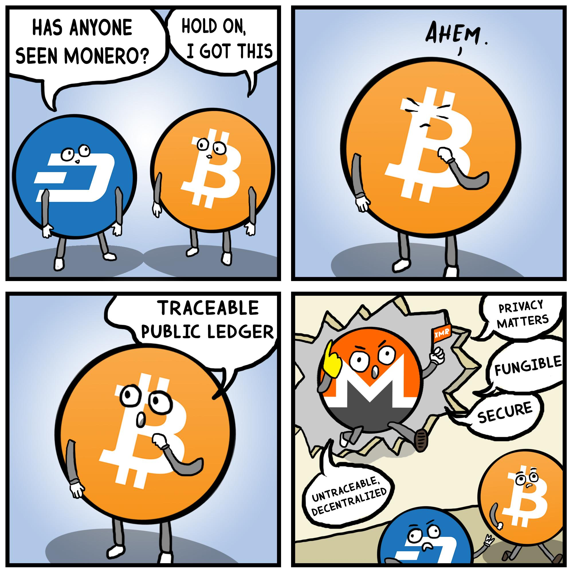
You may have met a Monero enthusiast in a situation like this:
(We can’t help it)
Source: https://www.reddit.com/r/moonero/comments/7h6ame/monero_in_da_house/

Slide 4



Real Problems Monero Addresses
Strong, ubiquitous privacy
Coin equality (fungibility)
Accessible PoW mining (RandomX)
Adaptive block size and fees

Slide 5
Real Problems Monero Addresses
Strong, ubiquitous privacy
Coin equality (fungibility)
Accessible PoW mining (RandomX)
Adaptive block size and fees

Slide 6
Cryptocurrency network privacy is less than the sum of its parts
 | Monero |  | Zcash |  | Grin |  | Bitcoin
 | Novice | Expert | Novice | Expert | Novice | Expert | Novice | Expert
Amount
Sender
Receiver
Tainted Coin and/or Suspicious Risk

Slide 7


Transaction Structure and Tracing
? XMR
? XMR
Ring Signature
? XMR
10 XMR
? XMR
? XMR
12 XMR
? XMR
5 XMR
3 XMR
Ring Signature
? XMR
? XMR
? XMR
? XMR

Slide 8

Transaction Structure and Tracing
? XMR
100 XMR
Ring Signature
? XMR
? XMR
? XMR
? XMR
? XMR
? XMR
? XMR
? XMR
Ring Signature
? XMR
? XMR
? XMR
? XMR

Slide 9
Transaction Tracing
Ring Signature
Ring Signature
? XMR
? XMR
? XMR
? XMR
Ring Signature
Ring Signature
? XMR
? XMR
? XMR
? XMR
? XMR
? XMR
Ring Signature
Ring Signature
? XMR
? XMR
+

Slide 10
Monero has REAL privacy, not POTENTIAL privacy

Slide 11
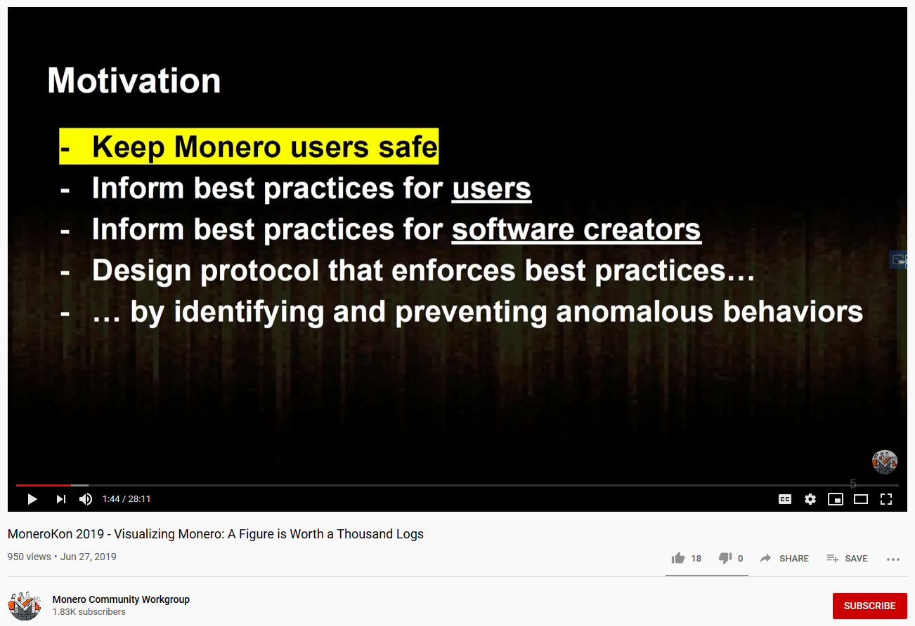
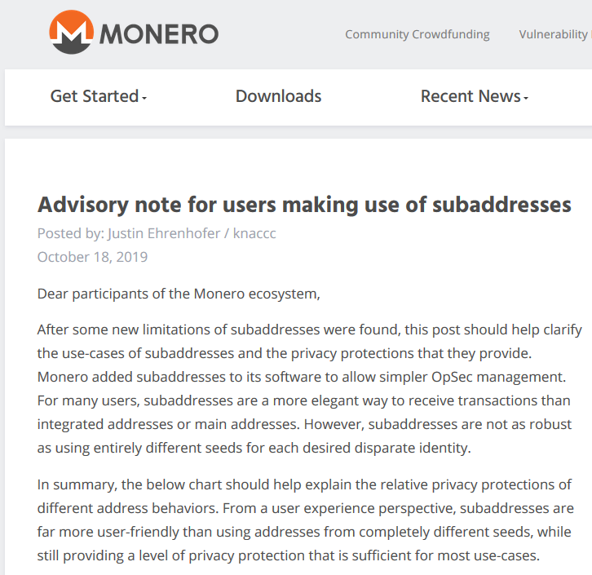
If there are issues with privacy, we discuss and patch them openly, not blame users
Notes:
Growth mindset

Slide 12
Optional CoinJoin zkSNARKs Lelantus CoinSwap PerfectlyPrivateTM
is a bad solution for the wrong problem

Slide 13
Results of a fungibility exercise
Name to Alice
Alice to Bob
Bob to Charlie

Slide 14
Results of a fungibility exercise
People avoided the tainted cards
Some would only accept tainted for “something extra”
Most people would pay more for “fresh cards”
In reality, who among the attendees pays for Chainalysis?
Name to Alice
Alice to Bob
Bob to Charlie

Slide 15
Reality
Chain analysis companies will most likely mark the use of any optional privacy as higher risk (this is enforced by several tools)
Mandatory mining to shielded doesn’t fix
Optional privacy often harms fungibility, not helps
Name to Alice
Alice to Bob
Bob to Charlie
Mixers
Z-addresses
PrivateSend
Wasabi
Samourai

Slide 16
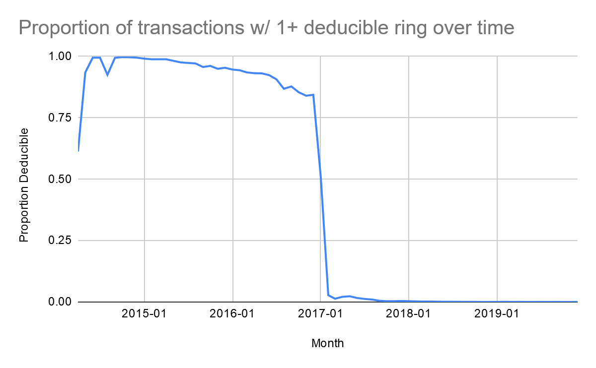
Privacy is hard. Coin equality is harder.
Source: Sarang Noether of Monero Research Lab using blockchain data

Slide 17
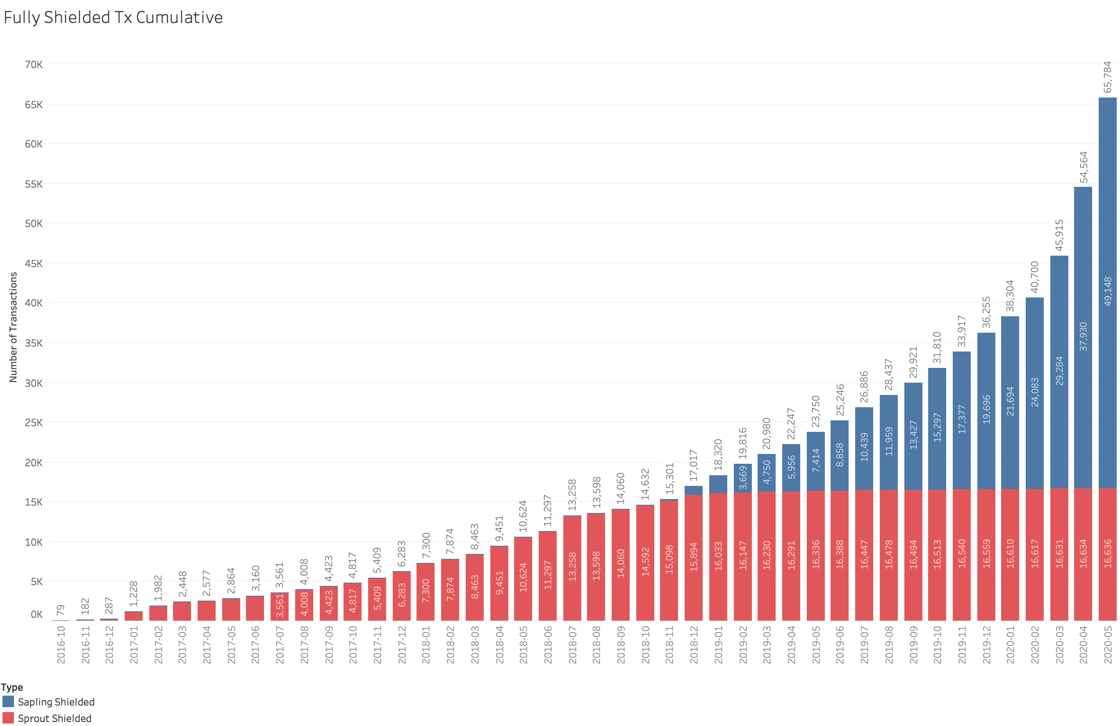

65,784
Source: https://forum.zcashcommunity.com/t/measuring-shielded-adoption/35022

Slide 18
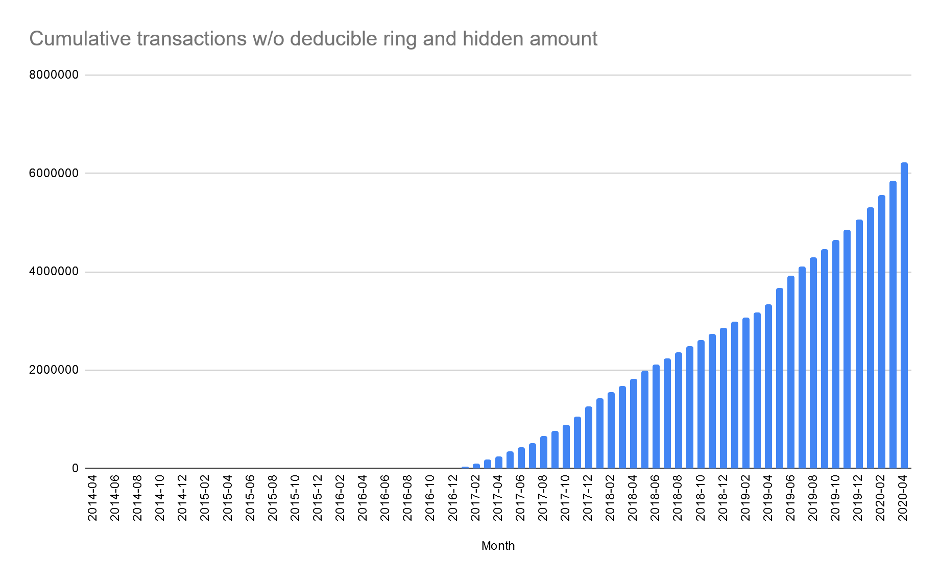
6,227,640
94,900
Monero without RingCT wasn’t great
Source: blockchain data from Sarang Noether of Monero Research Lab
Notes:
Nearly 100x difference

Slide 19
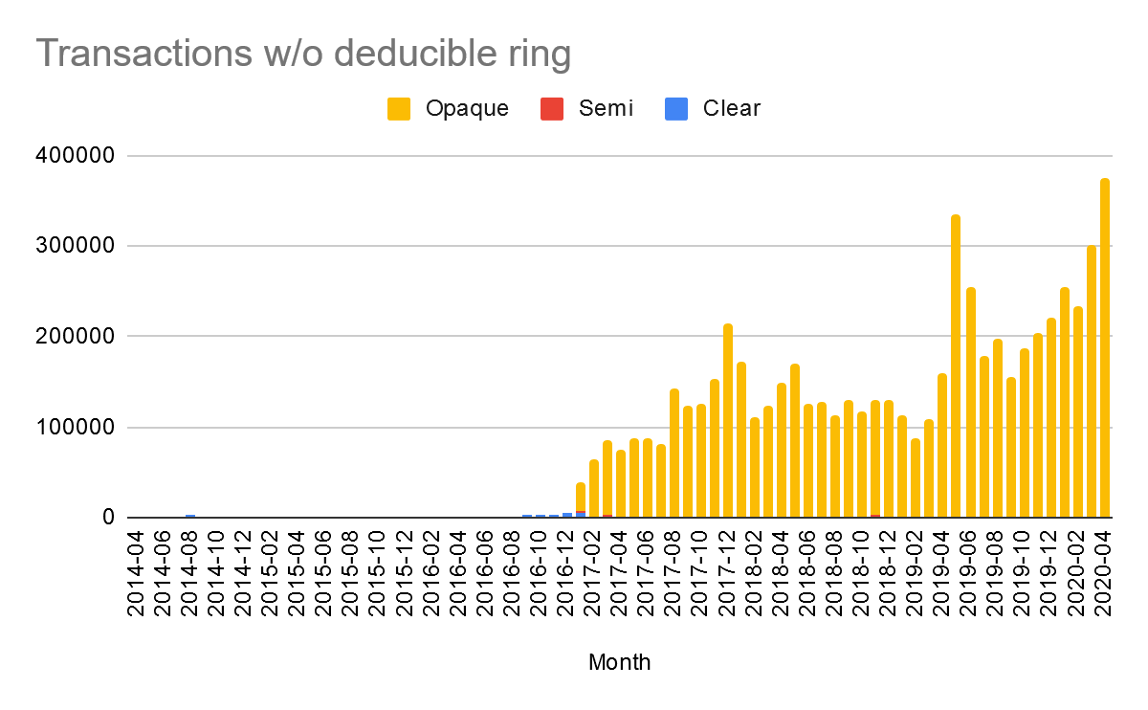
Since February 2017, Monero had more transactions each month protecting the sender, receiver, and amount than Zcash had in 3.5 years
Source: blockchain data from Sarang Noether of Monero Research Lab

Slide 20
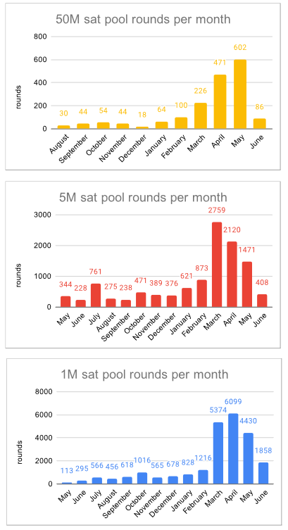
8,690
Source: https://mattodell.keybase.pub/whirlpoolstats.pdf
Notes:
1/10th of the LOWEST Monero monthly volume in the past year; Samourai

Slide 21

What’s next?
Today
<6 months
~12-18 months
CLSAG
More efficient transactions
Arcturus, Triptych
Larger ringsizes 128-256
Image credit Edge Wallet
Notes:
If a 19-year-old can make an impact, you can too

Slide 22

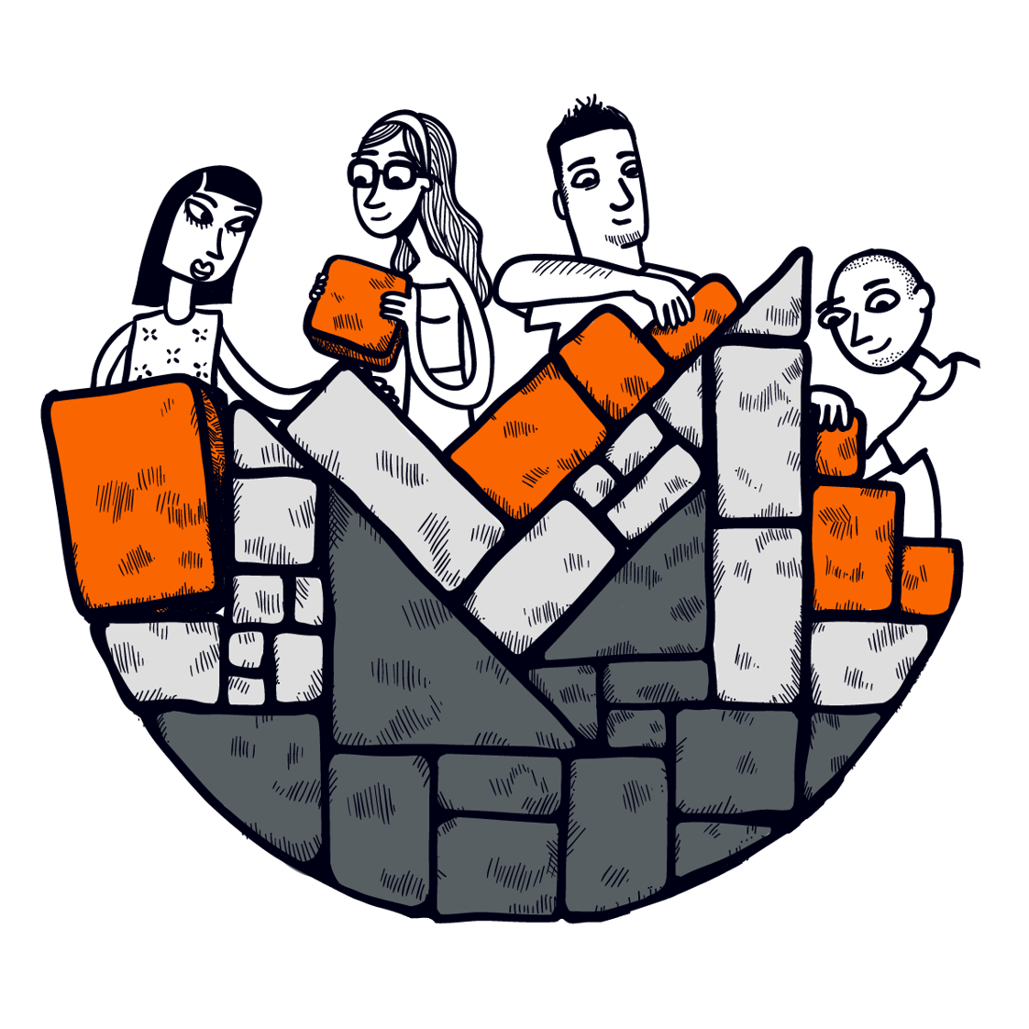

How YOU should participate
Get educated
masteringmonero.com
moneromeans.money
Get started
cakewallet.com
Join the community
communityworkgroup.org
Cake Wallet sponsored this meetup. Mastering Monero provided 3 free books for a giveaway.
Notes:
If a 19-year-old can make an impact, you can too

Slide 23
Conclusion
Monero transactions use ring signatures and stealth addresses
Monero beginners have reasonably strong privacy by default
Privacy needs to be thought of on a network implementation basis, not on a single-user basis
Monero is the only network that seems to care about real privacy
Monero is the only network that prevents mass surveillance
Watch for more efficient transactions soon, and much larger ringsizes in the medium-term future

Slide 24
Questions?
justin@ehrenhofer.org
@JEhrenhofer
Get educated
masteringmonero.com
moneromeans.money
Get started
cakewallet.com
Join the community
communityworkgroup.org

